Slide 1


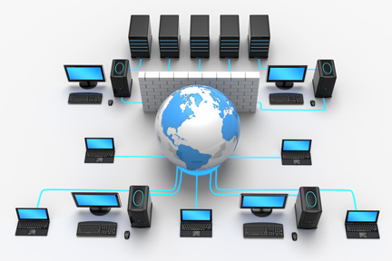
Web Technologies
FR
FABRIKAM RESIDENCES
ICT1153
Buddhika Gayashani Jayaneththi
Dept. Of ICT
Faculty of Technology
University of Ruhuna

Slide 2
Introduction to Internet
FR
FABRIKAM RESIDENCES

Slide 3

Learning Objectives
Identify the fundamentals of Internet
Identify the basic concepts of networking

Slide 4
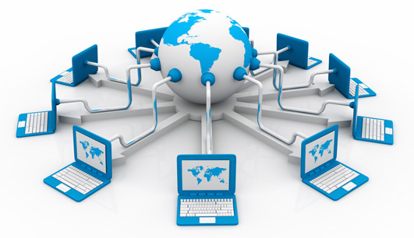
The Internet
A global network of computers
Network – A group of two or more computer systems linked together.
Facilitates communications of all kinds among the users all around the world.
In the late 1960s, ARPA (the Advanced Research Projects Agency) proceeded to implement the ARPANET, which eventually evolved into today’s Internet.

Slide 5
Evolution of the Internet
1969 - ARPA (Advanced Research Projects Agency) goes online
1972 - Electronic mail is introduced
1973 - Transmission Control Protocol/Internet Protocol (TCP/IP) is designed and in 1983 it became the standard for communicating between computers over the Internet
1984 - Domain Name System (DNS) is established, with network addresses identified by extensions such as .com, .org, and .edu.
1989 - Tim Berners-Lee of CERN (European Laboratory for Particle Physics) developed World Wide Web
1998 - Google arrived
2001 - Wikipedia created
2003 - Skype released
2004 - Facebook launched
2005- YouTube launched
2010- 4G wireless network

Slide 6
Network
A group of two or more computer systems linked together in order to,
share resources
exchange files
allow electronic communications
The computers may be linked through cables, telephone lines, radio waves, satellites, or infrared light beams.
Two very common types of networks,
LAN – Local Area Network
WAN – Wide Area Network

Slide 7
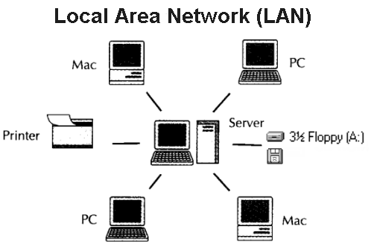
LAN
A network that is limited to a relatively small area
Ex: lab, school, building
Two components
Servers : Run continuously to provide services to the other computers on the network.
Workstation : Computers with a human user which interacts with the network through them.

Slide 8
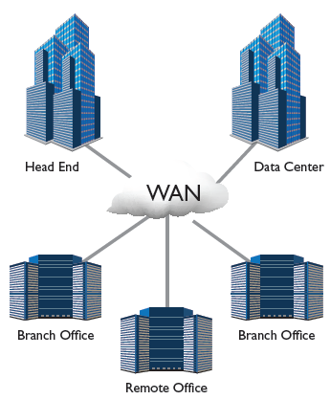
WAN
Connect networks in larger geographic areas.
Ex: Florida, Sri Lanka, or the world
Dedicated cabling or satellite uplinks may be used to connect this type of global network.

Slide 9
Packet Switching
A technique to allow multiple users to send and receive information simultaneously over the same communications paths (ex: phone lines)
Greatly reduced transmission costs
Digital data is sent in small bundles called packets
The packets contain address, error-control and sequencing information
Address - Allow packets to be routed to their destinations
Error-control – Handle the errors
Sequencing – Reassembling the packets

Slide 10
TCP/IP
Stands for Transmission Control Protocol / Internet Protocol.
A family of protocols for communication between computers.
Defines how electronic devices (like computers) should be connected over the Internet, and how data should be transmitted between them.
TCP : Responsible for breaking data down into small packets before they can be sent over a network, and for assembling the packets again when they arrive.
IP : Takes care of the communication between computers. It is responsible for addressing, sending and receiving the data packets over the Internet.

Slide 11
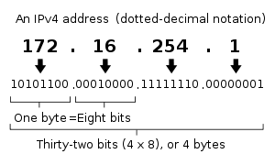
Internet Protocol Address
A numerical label assigned to each device (eg: computer, printer) participating in a computer network.
Each computer (known as a host) on the Internet has at least one IP address that uniquely identifies it from all other computers on the Internet.
IP address is a 32 bit binary number (IPv4).

Slide 12
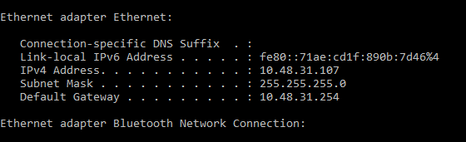
IP Address of Your Computer
Open command prompt
Type the command ipconfig

Slide 13
‘ping’ Command
Used to test the ability of the source computer to reach a specified destination computer.
The ping command is usually used as a simple way verify that a computer can communicate over the network with another computer or network device.
Ex:
ping 10.48.3.2
The two major pieces of information that the ping command provides are how many of responses are returned and how long it takes for them to return.

Slide 14

Services of Internet
Electronic Mail (E Mail)
News Groups
File Transfer Protocol (FTP)
Internet Relay Chat (IRC)
Voice/Video Communication –Skype
Social Networks
Search Engines
Wikipedia

Slide 15
Internet Applications and Its Usage
Sending messages, videos, voice recordings using electronic mail, Internet telephone, chat and video conferencing.
Document sharing, information gathering using file transfer protocol.
Stay up to date with news, sports, weather and any current affairs. around the world with information updated daily, hourly or instantly
Can listen to sounds and music, and watch digital movies.
Online buying and selling
E channeling
Online banking

Slide 16

Questions ???

Slide 17
Thank You.
Web Technologies-ICT1153
17

